Slide 1

Movie booking system
Team members：Zhang li
Wang pei wen
Wang xiu hua
Ma ming gao

Slide 2
Introduction to the ticketing system:
The ticket purchase system of the team is mainly composed of four parts, namely, user login, user registration, movie ticket selection and personal ticket purchase information query.
Among them, wang xiu hua is responsible for user login, wang pei wen is responsible for user registration, zhang li is responsible for movie ticket selection, and ma ming gao is responsible for individual ticket purchase information query.

Slide 3
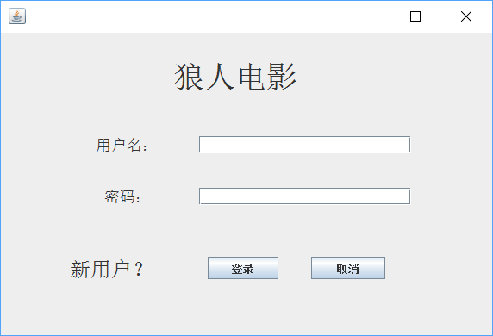
1. Part one：
In user login, the user can click "new user?"Button, enter the user registration interface for relevant registration, can also enter the account and password, relevant login.
The interface of user login

Slide 4
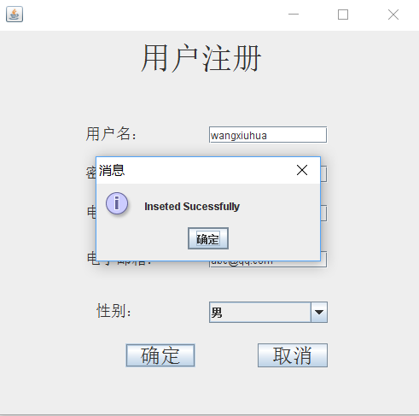
2. Part two：
In the user registration, the user's personal information is entered into the database for checking the information when the user logs in.When entering information, add a Regex exception to unify the input criteria.
The interface of user registration

Slide 5
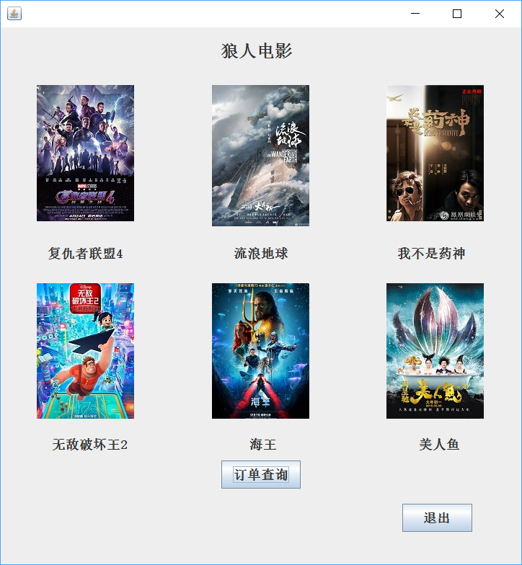
3. Part three：
In choosing a movie ticket, selection of main interface display first, the user can click on the corresponding film, enter the menu, know the film related introduction.
Then into the ticketing system, users can choose The Times, click ok, according to this the remaining votes, then choose to buy the ticket number, click ok according to the price, finally click on the confirmation of order, can tell the users to buy the movie information into the database.
The Menu

Slide 6
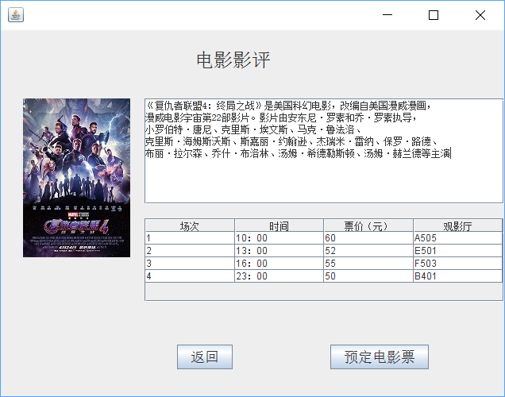
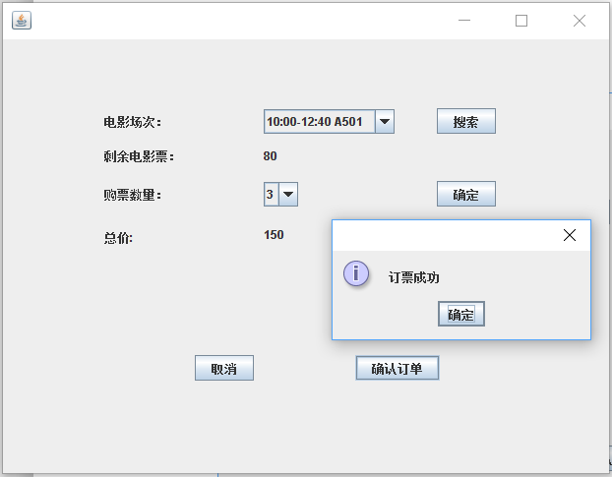
The mune for the film
Ticketing system

Slide 7
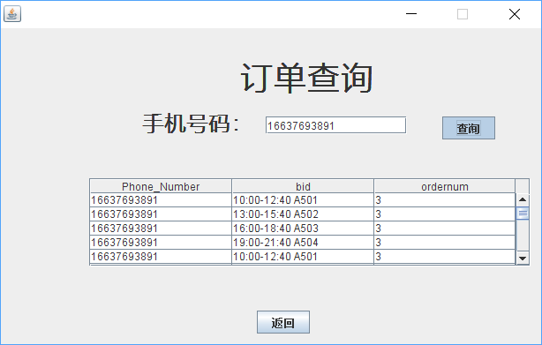
4. Part four：
In the query of personal ticket purchase information, the user can input his/her personal telephone number, click "ok", the program will connect to the database, extract the relevant information of the user's ticket purchase and display it.
personal information query

Slide 8
Thanks for watching

